Slide 1

Reorder & Revenue Opportunity Analysis
206,209 customers, 3.2M+ orders

Slide 2
PROBLEM STATEMENT
Instacart is a grocery delivery marketplace. Its revenue model depends on order frequency — the more often customers reorder, the more Instacart earns per customer over time. The growth team has noticed that a large share of customers who placed their first order never place a second one, and among those who do reorder, a meaningful portion go quiet after a few orders.
01 FUNNEL
02 REVENUE OPPORTUNITY
What behaviors in orders 1–4 separate high-value customers from at-risk ones — and how large is the gap between them?
At which step in the reorder journey are we losing the most customers, and which product categories show the highest drop-off?

Slide 3
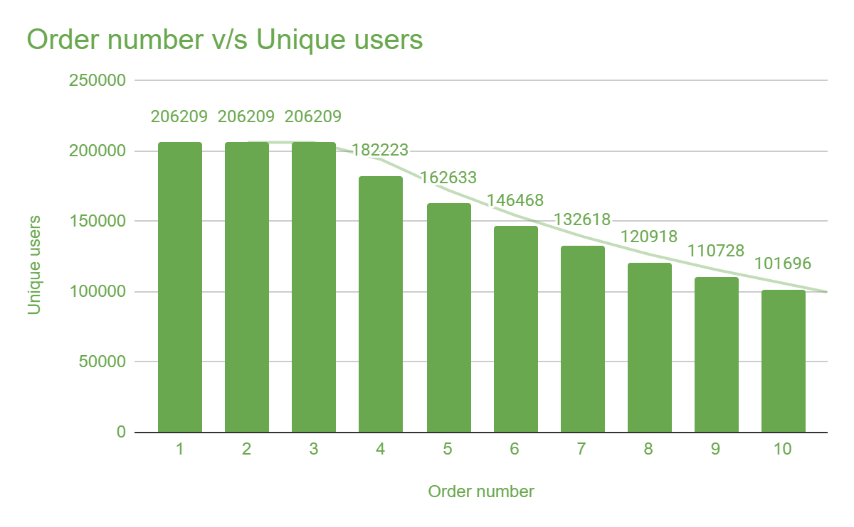
REORDER FUNNEL
The steepest single-step drop-off is at Order 4 → 5
11.63%
drop-off at Order 4 → 5
largest single step drop
21.13%
of all users lost
by Order 5

Slide 4
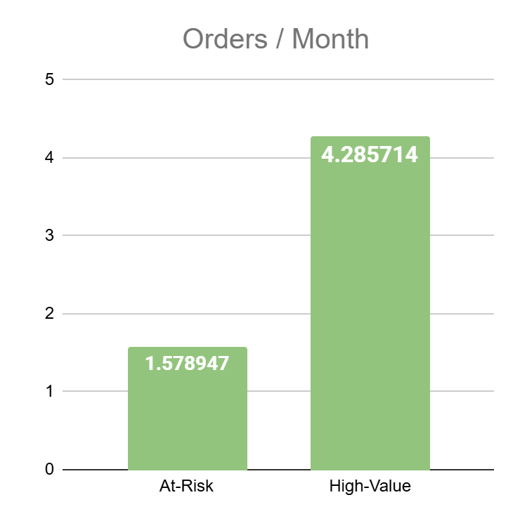
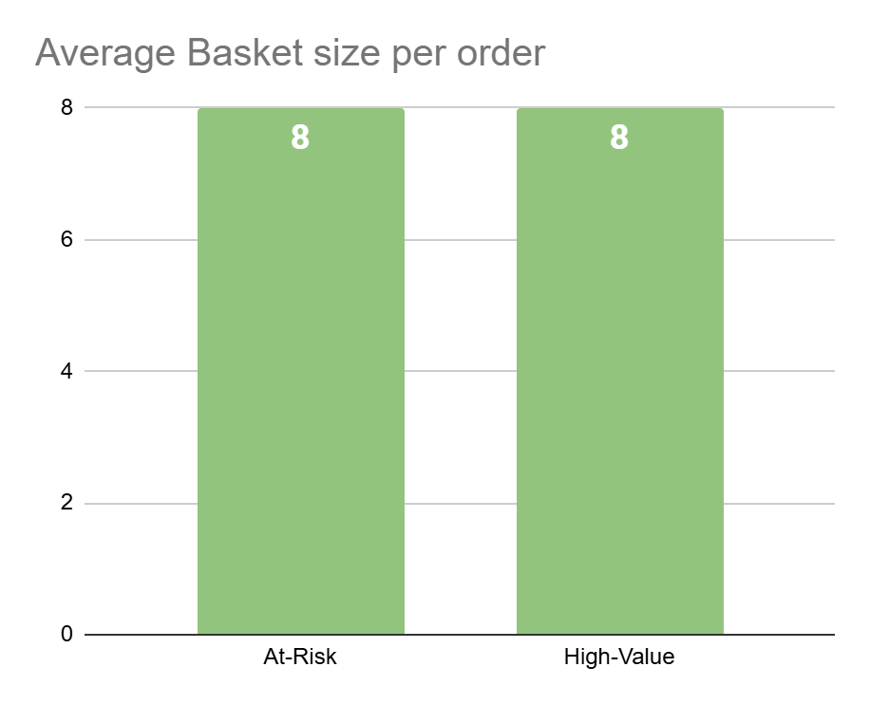
REVENUE GAP · CUSTOMER SEGMENTS
This is a frequency problem, not a basket size problem
2.7×
Revenue proxy gap
High-Value vs At-Risk
Both segments buy the same amount per order (median 8 items). High-Value customers order every 7 days vs every 19 days for At-Risk. Interventions should target reorder timing — not cart size.
High-Value n=45,407 (22%) · At-Risk n=116,662 (57%) · Neither n=44,140 (21%)

Slide 5
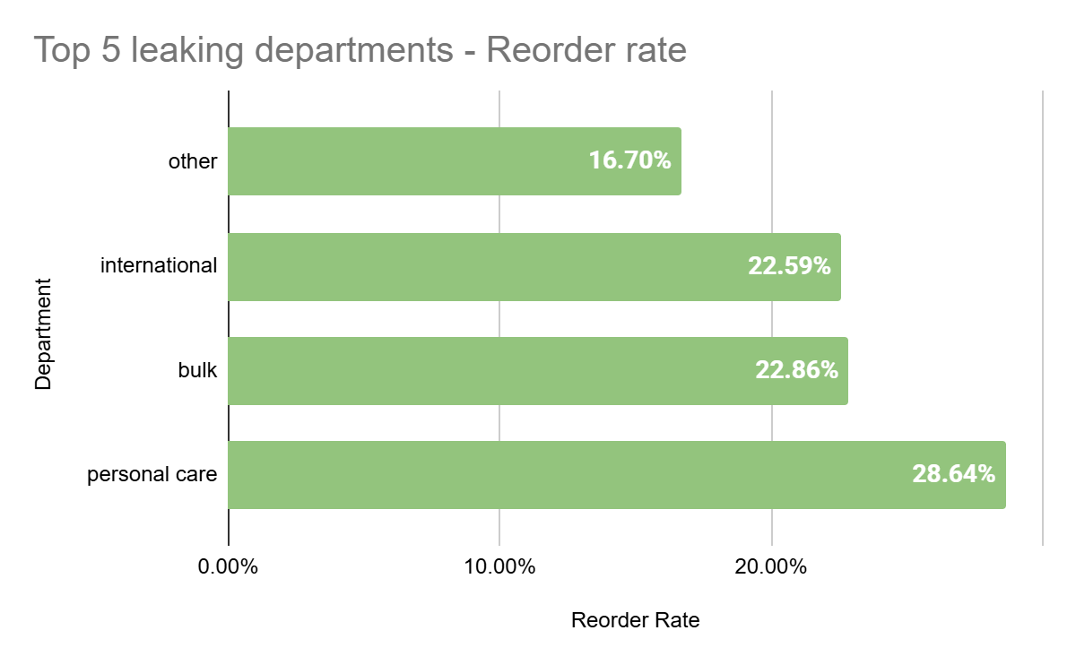
CATEGORY LEAKAGE · AT-RISK CUSTOMERS
ACT HERE FIRST
Personal Care
28.6% reorder rate
Only 3,830 of 13,372 At-Risk customers who bought from this dept in Order 1 came back by Order 3 — the lowest absolute reorder rate among high-volume departments. Consumables like shampoo and toothpaste should drive repeat purchases; low reorder rates signal Instacart is losing this volume to competitors.
Reorder rate = share of At-Risk users who bought from a dept in Order 1 and again by Order 3

Slide 6
RECOMMENDATION
A targeted in-app prompt at Order 2 — timed to reorder risk
THE TRIGGER
THE INTERVENTION
THE TEST
Customers whose days_since_prior_order exceeds the median (7 days for High-Value) after Order 1 are flagged. This identifies at-risk customers at the earliest actionable moment.
A personalised in-app prompt at Order 2 featuring the top-dropped department from their Order 1 basket.
Priority departments: Personal Care (lowest absolute reorder rate, 28.6%) and Alcohol (largest gap vs High-Value, 15 percentage points).
A/B test the prompt against a control group.
Primary metric: days to next order. Secondary: basket size at Order 3.
Key findings: 2.7× revenue proxy gap. Biggest drop-off at Order 4→5 (11.63%). Lowest reorder rate: Personal Care (28.6%) Alcohol: largest At-Risk vs High-Value gap (15pp) · Frequency problem so fix timing, not basket size.

